Slide 1
Cross-Layer Anomaly Detection in an SDN-Enabled Heterogeneous Network
Team 14
Achu Jayan (3202501)
Rishav Datta (3252570)
Sambit Sahoo (3161365)

Slide 2
Problem and Motivation
Problem Statement: Design and development of SDN-controlled heterogeneous network testbed for cross-layer telemetry-based anomaly detection.
Alex a Network Operations Engineer is flooded with alarms from multiple dashboards. Customers are complaining, services are down. Hours spent on investigation, yet nobody knows where the problem actually started.
The real challenge is an anomaly that can propagate and appear as a performance problem.
What if we could collect telemetry from multiple layers, correlate the information, and automatically detect anomalies under centralized SDN control?
Alex would be able to detect anomalies earlier, identify the root cause faster, and reduce troubleshooting effort and downtime.

Slide 3
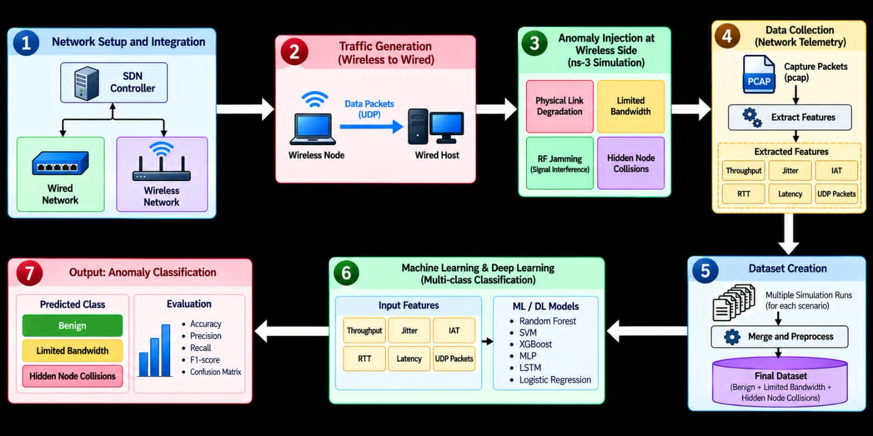
System Workflow

Slide 4
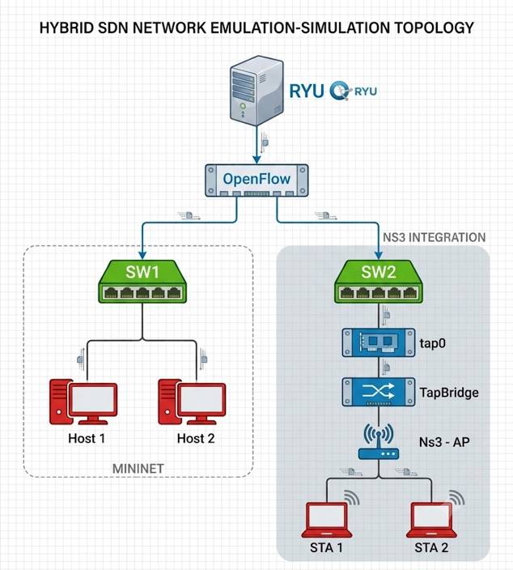
Tools Used & Topology
Mininet: Emulates wired topology, hosting virtual endpoints (h1, h2) and OpenvSwitch instances (sw1, sw2)
Ns-3: Simulates 802.11g wireless network (AP, STAs) & executes wireless fault injections.
Ryu-SDN Controller: Centralized control plane executing Layer2 learning switch logic and managing forwarding state.
OpenFlow(v1.3): Southbound protocol, installing dynamic flow match rules from Ryu down into switches.
Linux TAP & TapBridge: Bridges Mininet OVS bridge to Wi-Fi stack via tap0 in UseBridge mode, for cross layer telemetry collection.

Slide 5
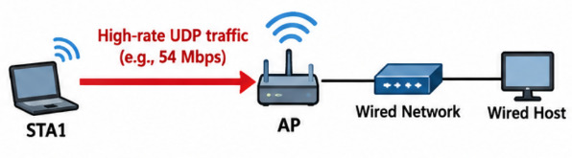
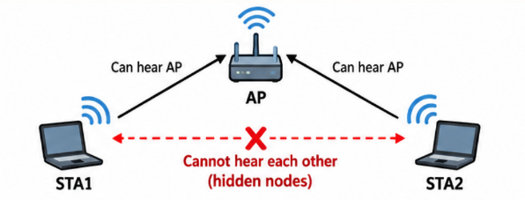
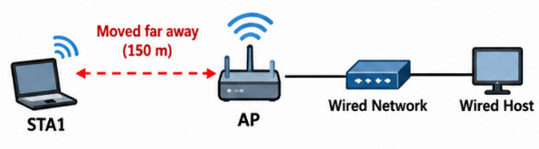
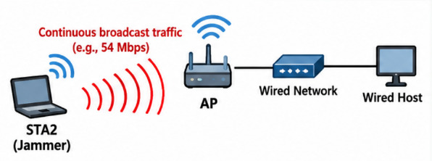
Fault Scenarios
Limited Bandwidth
Generates a continuous 54 Mbps UDP flood using large 1024-byte packets.
This Uplink DoS exhausts the 802.11g channel capacity, forcing the Access Point's transmission queues to overflow.
Hidden Node Collisions
STA 1 and STA 2 Nodes are physically separated so that their carrier sense mechanisms cannot detect each other.
Simultaneous transmissions physically collide at the Access point antenna, destroying the packets.
Physical Link Degradation
Manipulates node coordinates to mid simulation to force a 150-meter separation.
This abruptly drops the Signal-to-Noise Ratio (SNR), causing MAC frame drops and total loss of Wi-Fi association.
RF
Jamming
A rogue node blasts continuous raw radio frequency energy across Wi-Fi Channel 1.
Legitimate nodes sense a busy medium via CSMA/CA and pause transmissions, causing extreme queue delays.

Slide 6

Methodology
01
02
03
04
EMULATE
INJECT
OBSERVE
LEARN
STACK
WIRELESS
OPENFLOW
FEATURES
Mininet 2.3 · OVS
OpenFlow 1.3 · NS-3
Limited BW, Collision
RF Jamming
port + flow counters
counters → rates
5 stats per window
QUEUE
TOPOLOGY
GRID
backlog · drops
MODELS
2 switches · 4 hosts
1 AP · 2 stations
4 fault types
× 2 severity levels
RADIO
LR · LSTM
SVM · RF · XGBoost
RTT · JITTER
retries
TRAFFIC
SCHEDULE
EVALUATION
UDP traffic
Multiple 3000 episodes
randomised order
END-TO-END
Macro F1, Precision, Recall, Accuracy
RADIO
UDP
ping
NS-3 802.11g
log-distance exp 3.5

Slide 7
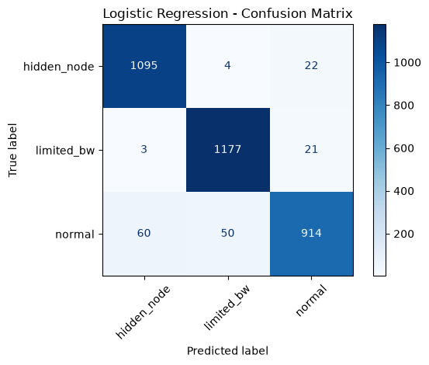
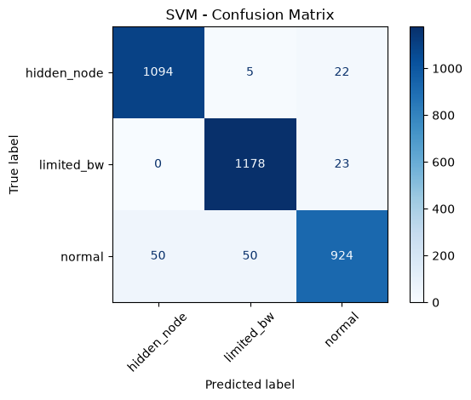


Results
Logistic Regression (Macro F1 – 0.95)
SVM (Macro F1 – 0.95)
 | Pre | Rec | F1
Normal | 0.96 | 0.89 | 0.92
Limited Bandwidth | 0.96 | 0.98 | 0.97
Hidden Node Collisions | 0.95 | 0.98 | 0.96
 | Pre | Rec | F1
Normal | 0.95 | 0.90 | 0.93
Limited Bandwidth | 0.96 | 0.98 | 0.97
Hidden Node Collisions | 0.96 | 0.98 | 0.97
Random Forest (Macro F1 – 0.96)
XG Boost (Macro F1 – 0.96)
 | Pre | Rec | F1
Normal | 0.96 | 0.92 | 0.94
Limited Bandwidth | 0.98 | 0.98 | 0.98
Hidden Node Collisions | 0.95 | 0.98 | 0.97
 | Pre | Rec | F1
Normal | 0.95 | 0.93 | 0.94
Limited Bandwidth | 0.98 | 0.98 | 0.98
Hidden Node Collisions | 0.96 | 0.98 | 0.97

Slide 8
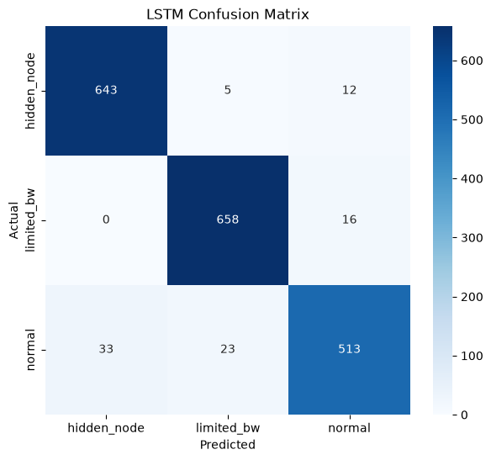
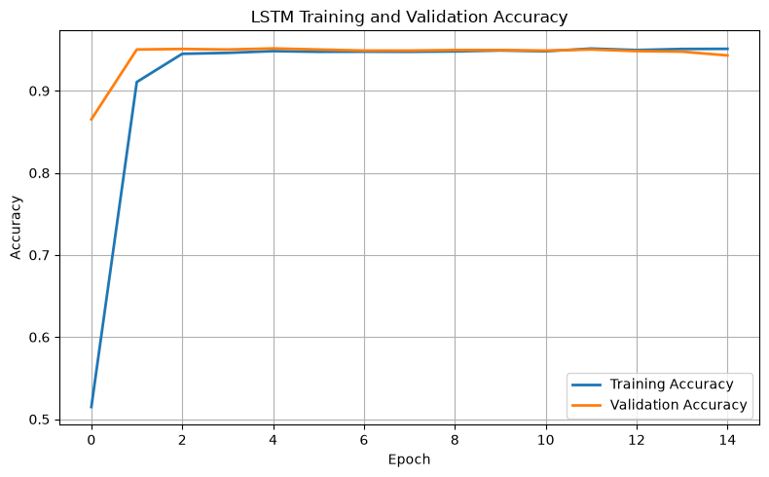
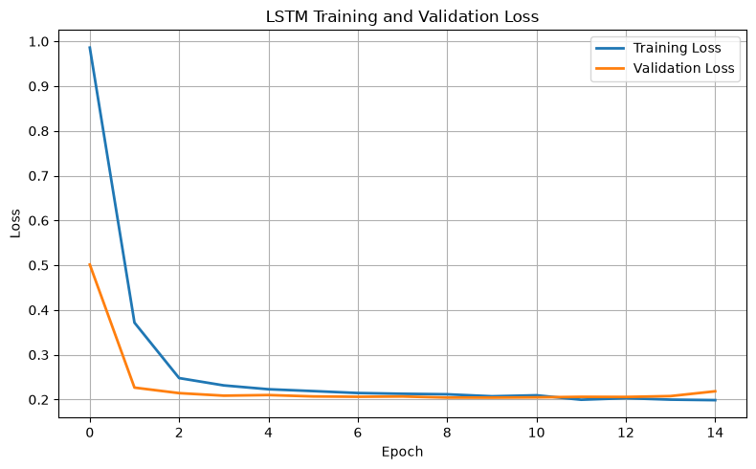
Results
Q: Why the Ensemble Models Outperformed LSTM?
LSTM (Macro F1 – 0.95)
Better suited for tabular data: Ensemble Models effectively learns patterns directly from structured network features such as latency, jitter, packet loss, and throughput.
Limited temporal dependency: Although the dataset contains temporal sequences, the fault classes appear to be more strongly distinguishable from feature-level patterns than from long-term temporal dependencies
 | Pre | Rec | F1
Normal | 0.95 | 0.90 | 0.92
Limited Bandwidth | 0.96 | 0.98 | 0.97
Hidden Node Collisions | 0.95 | 0.97 | 0.96

Slide 9
Future Scope
Real-Time Monitoring Platform
Convert the model into a system that continuously monitors network traffic and detects anomalies in real time.
Automated Fault Identification & Alerts
Automatically classify network problems and provide instant alerts to administrators with fault severity.
Interactive Monitoring Dashboard
Develop a user-friendly dashboard displaying network health, detected anomalies, trends, model confidence, and historical incidents.
Automated Root-Cause Analysis
Extend the system beyond detection to identify the probable cause of a network fault and recommend corrective actions.
Scalable & Deployable Solution
Package the solution for deployment across different enterprise and heterogeneous networks, with continuous updates.

Slide 10
Thank You

